Slide 1

Foss Fest September 2025 – National Hackathon
Problem Statement Title:
External App Launcher widget
Team Name: Quantum Stack

Slide 2
Problem Statement
Teams use multiple SaaS tools (Google Meet, Zoom, GitHub, etc.)
Switching between platforms disrupts workflow
No centralized workspace for external apps
Static dashboards, lack of dynamic iFrames
Security & usability concerns

Slide 3
Project Introduction
Vue.js-based Nextcloud widget
Add, edit, remove apps with icons & categories
Launch in iframe or new tab
Track usage counts

Slide 4
Solution Approach – Frontend
Vue.js 3 (Nextcloud framework)
AddAppForm for app details
AppItem for display & usage stats
PreviewOverlay with sandboxed iframe
OAuthPopup for private apps

Slide 5
Solution Approach – Backend
Node.js + Express API
/api/apps → manage apps
/api/auth → login & register
/api/apps/:id/usage → track usage
Optional OAuth API
Data storage in JSON files / DB

Slide 6
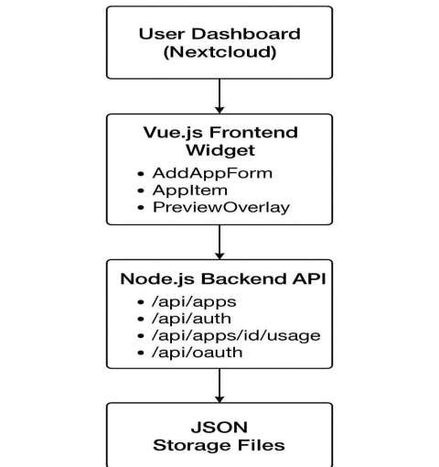
System Architecture

Slide 7
User Interface
Dashboard with app icons & categories
Buttons: Open, Preview, Edit, Delete
Add apps via form
Suggestions panel
Resizable iframe previews

Slide 8
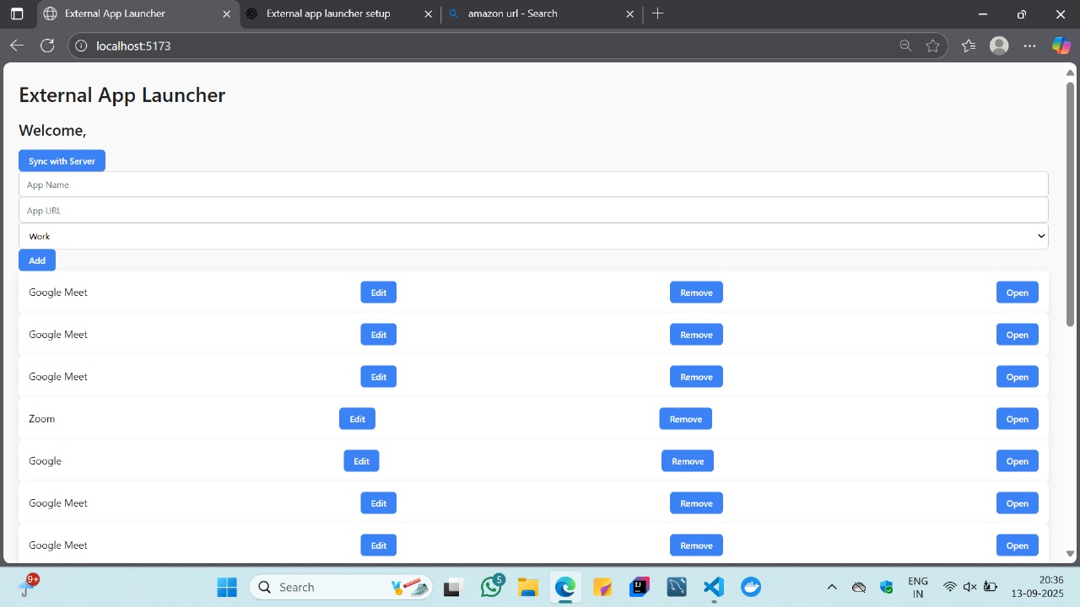
Dashboard

Slide 9
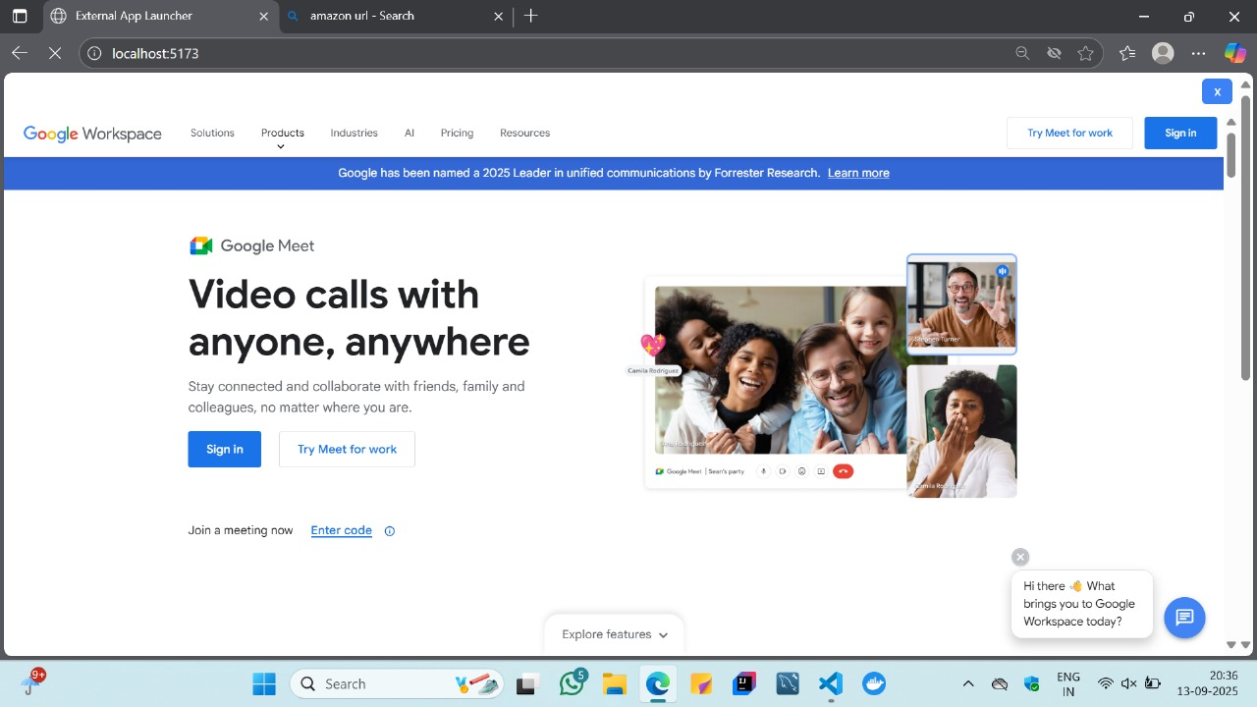
App Launcher

Slide 10
Advantages
Centralized app management
Secure sandbox integration
Customizable & user-friendly
Track app usage
Future-ready (OAuth, DB support)

Slide 11
Challenges & Solutions
Embedding sites securely → sandboxed iframes
Missing icons → placeholder icons
OAuth integration → popup & encrypted tokens
Offline access → localStorage caching

Slide 12
Conclusion
Personalized & secure dashboard for Nextcloud
Reduces context switching
Protects sensitive data
Supports modular enhancements
Creates modern digital workspace hub

Slide 13
Future Improvements
OAuth for private apps
Drag-and-drop arrangement
Category filters & search
Database integration (PostgreSQL/MySQL)
App update notifications

Slide 14
Reference
Nextcloud Developer Documentation
Vue.js Official Guide
iframe Security Docs
OAuth 2.0 Documentation

